Slide 1
Does the data splitting strategy matter?
DA/ML 김민서

Slide 2
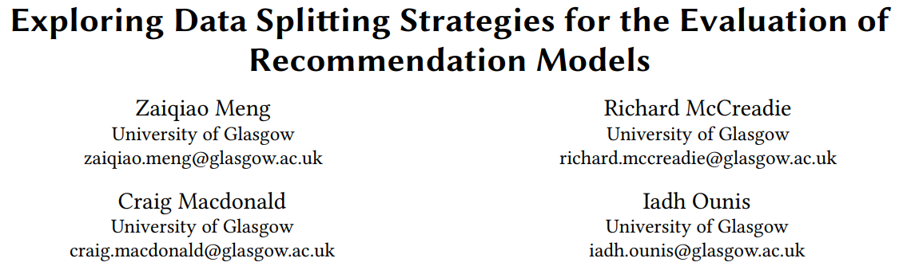

Slide 3
Compare to each other!
Regression
RMSE
RAE
MSE
Classification
Accuracy
Recall
F1 score
모델 A
모델 B
모델 C
vs
vs
∴ A > B > C

Slide 4
Confounding variable: Data Split
Regression
RMSE
RAE
MSE
Classification
Accuracy
Recall
F1 score
모델 A
모델 B
모델 C
vs
vs

Slide 5
Data Splitting Strategy
Leave One Last
- Leave One Last Item
- Leave One Last Basket/Session
2. Temporal User/Global Split
3. Random Split
4. User Split

Slide 6
Leave One Last Strategy
user
Leave One Last Item/basket/session
Arrange items in temporal order
Testing set: last interaction
Validation set: (last – 1) interaction
Training set: remaining interaction
Advantage
Training set이 최대가 된다.
Weakness
Test set이 적다.
Future Data Leakage problem
training
validation
Time
testing

Slide 7
Temporal Split Strategy
User or Global
Temporal User Split
Arrange items in temporal order
-> Split interactions at a constant rate
Temporal Global Split
Arrange items in temporal order
Set a fixed time point
Split interactions to train_val and test set depending on point
Split train_val to validation and training set at a constant rate
Advantage
Realistic splitting strategy
Weakness
Training set이 적다.
training
validation
testing
Time

Slide 8
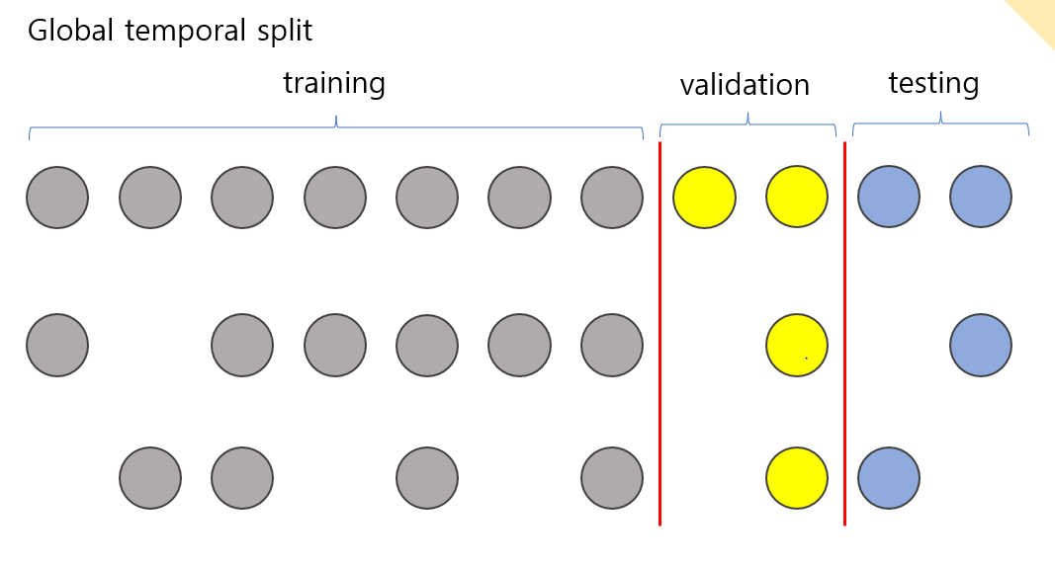

Slide 9

User Split Strategy
아이템
Training
$$R:\left|U\right|×\left|I\right|$$
사용자
Validation
Testing

Slide 10
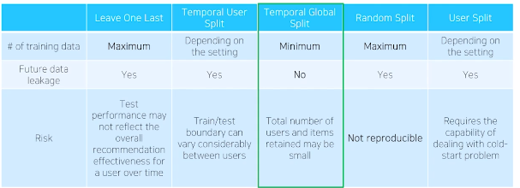

Slide 11
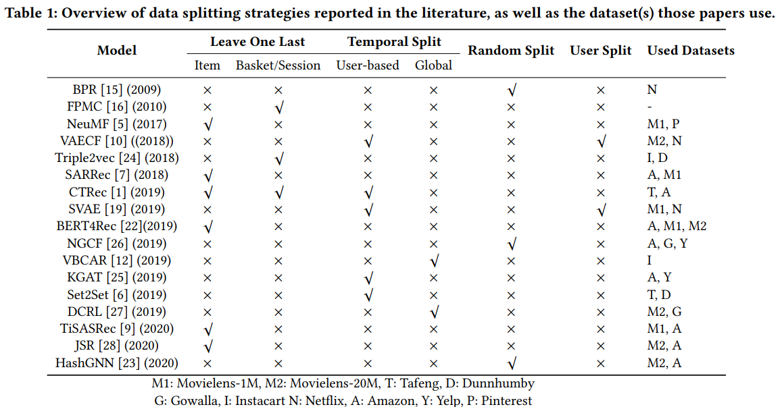

Slide 12
Does the data splitting strategy matter?

Slide 13
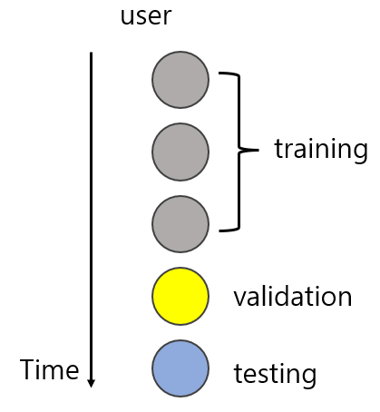

Experimentation: Data Split Strategy
Leave one last item/basket
Global temporal split

Slide 14
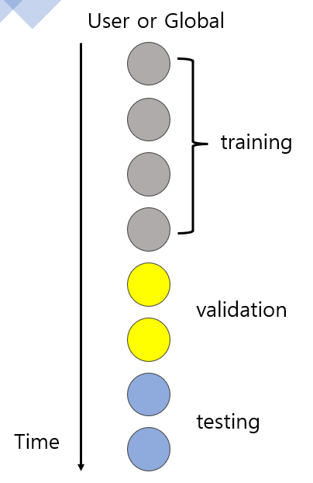

$$≈$$

Slide 15
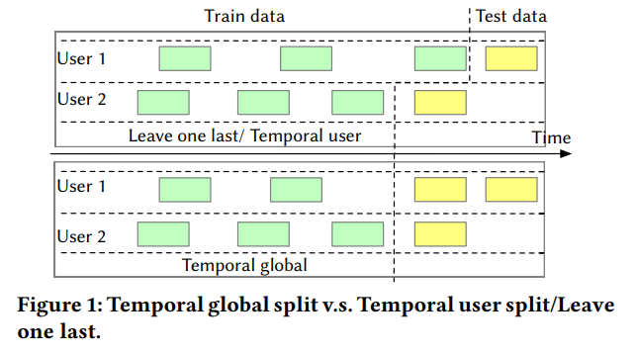

Slide 16
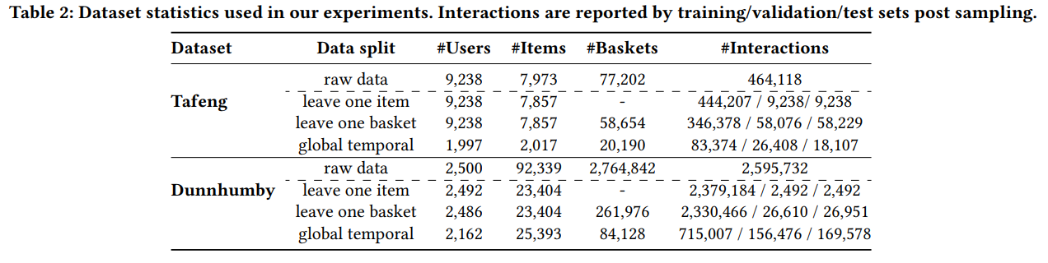

Slide 17
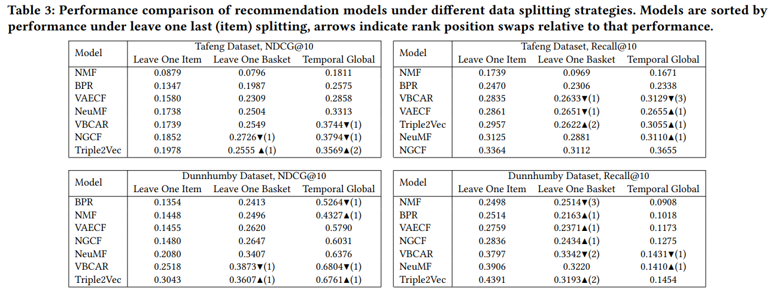

Slide 18
